Slide 1
FIN 654: FINANCIAL Analytics
SUPPLEMENT Week 1
Note: Code contained here is from a mix of sources as listed in References Slide(s)

Slide 2
TOOLS & SOFTWARE
R
R Studio
LaTeX (MikTeX or MacTeX)
R Packages
devtools::install_github('rstudio/rmarkdown’)
install.packages("yaml")
install.packages("installr")
… and many others as needed …

Slide 3
In the beginning
## Set and Check Working Directory
## setwd("...") where "..." is folder path
getwd()
## Manage workspace clutter
ls() # list objects in environment
rm(list=ls()) # remove all objects
## NA versus NULL
class(NULL)
NULL == 0
length(NULL)
class(NA)
NA == 0
length(NA)

Slide 4
Variables in r
## VECTOR ##
s <- 1:3
print(s)
s
(s <- 1:3)
(s <- seq(1,3))
(s <- rep(1,3))
(s <- 3)
(s <- c(5.1,10.1,15.1))
names(s) <- c("Lo", "Med", "Hi")
## LIST ##
w <- list(name="Fred", age=33, favs=c("blue","green"))
w$age
## FACTOR ##
s <- c("Yes","No","No","Yes","Yes")
(f <- factor(s))
levels(f)
## TABLE ##
s <- c("Yes","No","No","Yes","Yes")
(t <- table(s))

Slide 5
Matrix and data frame
## MATRIX ##
X <- matrix(c(3, 4, 9, 2, 7, 1), nrow=3, ncol=2)
X
t(X) # transpose of X
Y <- matrix(c(5, 8, 6), nrow=3, ncol=1)
Y
t(X) %*% Y
cbind(X, Y)
Z <- matrix(c(0, 8), nrow=1, ncol=2)
rbind(X, Z)
## DATA FRAME ##
d <- c(1,2,3,4)
e <- c("red", "white", "red", NA)
f <- c(TRUE,TRUE,TRUE,FALSE)
my.data <- data.frame(d,e,f)
colnames(my.data) <- c("Serial","Color","BLIS") # names
rownames(my.data)<- c("C1", "C2", "C3", "C4")
my.data
na.omit(my.data)
mydata <- na.omit(my.data)

Slide 6
Reading & Writing a File
# Read data into a variable called x.data
x.data <- read.csv("data/hospitals.csv")
# Fix missing (NA) values
x.data <- na.omit(x.data)
# Explore the data
head(x.data, n=3)
tail(x.data, n=3)
summary(x.data)
# Write data with a different file name
write.csv(x.data, file="data/hospitals2.csv", row.names=FALSE)

Slide 7
Finance PV exercise
rates <- c(0.06, 0.07, 0.05, 0.09, 0.09, 0.08, 0.08, 0.08)
a <-1
t <- seq(1, 8)
pv.1 <- sum(a/(1 + rates)^t)
pv.1
salvage <- 5
pv.salvage <- salvage/(1 + rates[8])^8
pv.salvage
t <- seq(1, 8)
salvage <- 5
cashflow <- rep(10, 8)
cashflow[8] <- cashflow[8] + salvage
pv.machine <- sum(cashflow/(1 + rates)^t)
pv.machine

Slide 8
Graphing with ggplot
set.seed(1016)
n.sim <- 10
x <- rnorm(n.sim)
y <- x/(rchisq(x^2, df = 3))^0.5
z <- c(x, y)
indicator <- rep(c("normal", "abnormal"), each = length(x))
xy.df <- data.frame(Variates = z, Distributions = indicator)
require(ggplot2)
require(ggplot2)
# set up a blank canvas
ggplot(xy.df, aes(x = Variates, fill = Distributions))
# insert a geometrical element
ggplot(xy.df, aes(x = Variates, fill = Distributions)) + geom_density(alpha = 0.3)
# zoom in with xlim
ggplot(xy.df, aes(x = Variates, fill = Distributions)) + geom_density(alpha = 0.3) + xlim(-1, 6)

Slide 9
Regression Basics
n.sim <- 100
x.1 <- rgamma(n.sim, 0.5, 0.2)
x.2 <- rlnorm(n.sim, 0.15, 0.25)
X <- cbind(x.1, x.2)
y <- 1.5 * x.1 + 0.8 * x.2 + rnorm(n.sim, 4.2, 5.03)
hist(y)
X <- cbind(x.1, x.2)
XTX.inverse <- solve(t(X) %*% X)
(beta.hat <- XTX.inverse %*% t(X) %*% + y)
e <- y - X %*% beta.hat
(e.sse <- t(e) %*% e)
(n <- dim(X)[1])
(k <- nrow(beta.hat))
(e.se <- (e.sse / (n - k))^0.5)
actual <- y
predicted <- X %*% beta.hat
residual <- actual - predicted
(results <- data.frame(predicted = predicted, residual = residual))

Slide 10
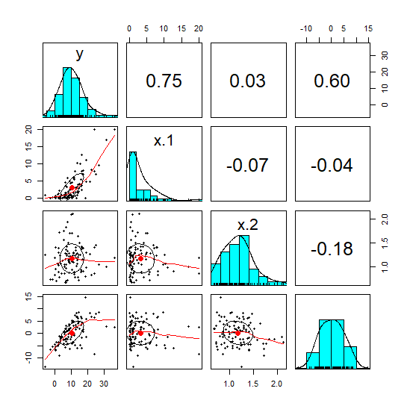
Correlations & Scatterplots
require(psych)
all <- cbind(y, X, e)
str(e)
str(y)
str(X)
str(all)
pairs.panels(all)

Slide 11
Reference books
Bennet and Hugen. 2016. Financial Analytics with R: Cambridge Univ Press.
Paul Teetor. 2011. R Cookbook. O’Reilly: Sebastopol, CA.
Phil Spector. Data Manipulation with R.
Norman Matloff. The Art of R Programming: A Tour of Statistical Software Design.
John Taveras. R for Excel Users at https://www.rforexcelusers.com/book/.
Winston Chang. 2014. R Graphics Cookbook. O’Reilly: Sebastopol, CA.

Slide 12
Reference links
http://www.cookbook-r.com/
https://books.google.com/books?id=fxL4tu5bzAAC&printsec=frontcover
https://www.datacamp.com/courses/free-introduction-to-r
http://www.r-tutor.com/r-introduction/
https://www.statmethods.net/
https://livebook.manning.com/#!/book/r-in-action-second-edition/
https://blog.rstudio.com/2015/06/24/leaflet-interactive-web-maps-with-r/
https://www.analyticsvidhya.com/blog/2015/07/guide-data-visualization-r/
https://jabranham.com/blog/2015/09/rmarkdown-vs-latex/
https://www.revolvy.com/main/index.php?s=YAML

